Slide 1
Agile
Session 2
Notes:
Welcome to agile second session
How was your one week break?
Today we will have a guest. We will talk about agile practises in real world. It will be a question and answer session.
Take your coffees, take your teas and enjoy the class today.

Slide 2

Did you finish the Agile (Scrum & Kanban) pre-class activity?
Notes:
🍐 This is a Pear Deck Multiple Choice Slide. Your current options are: A: I finished completely., B: I finished partially., C: No, I didn't finish.,
🍐 To edit the type of question or choices, go back to the "Ask Students a Question" in the Pear Deck sidebar.

Slide 3

Table of Contents
SCRUM
Scrum Overview
Scrum Roles
Epic, User Story and Task
Scrum Artifacts
Scrum Ceremonies
KANBAN
Kanban Overview
Kanban Board
Principles of Kanban
Practices of Kanban
Kanban vs Scrum
Notes:
In this slide you see the topics
Last lesson we have talked about scrum and scrum roles. Today we will quickly make a summerry about those to remember the scrum.
Than we will focus on epic user story and task as well as scrum artifacts and ceremonies.
In the last hour of this session we will discuss what kanban is.

Slide 4
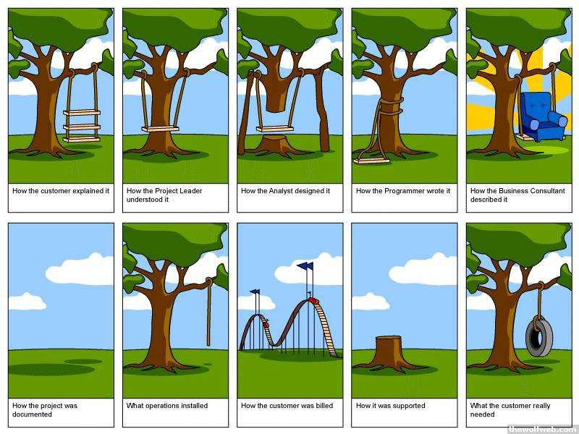
Notes:
What do you think about this slide?

Slide 5
SCRUM
Notes:
Now keep on scrum

Slide 6
Scrum Overview
1
Notes:
Last session we talked about scrum.
Scrum is an agile development methodology used in the development of Software.

Slide 7
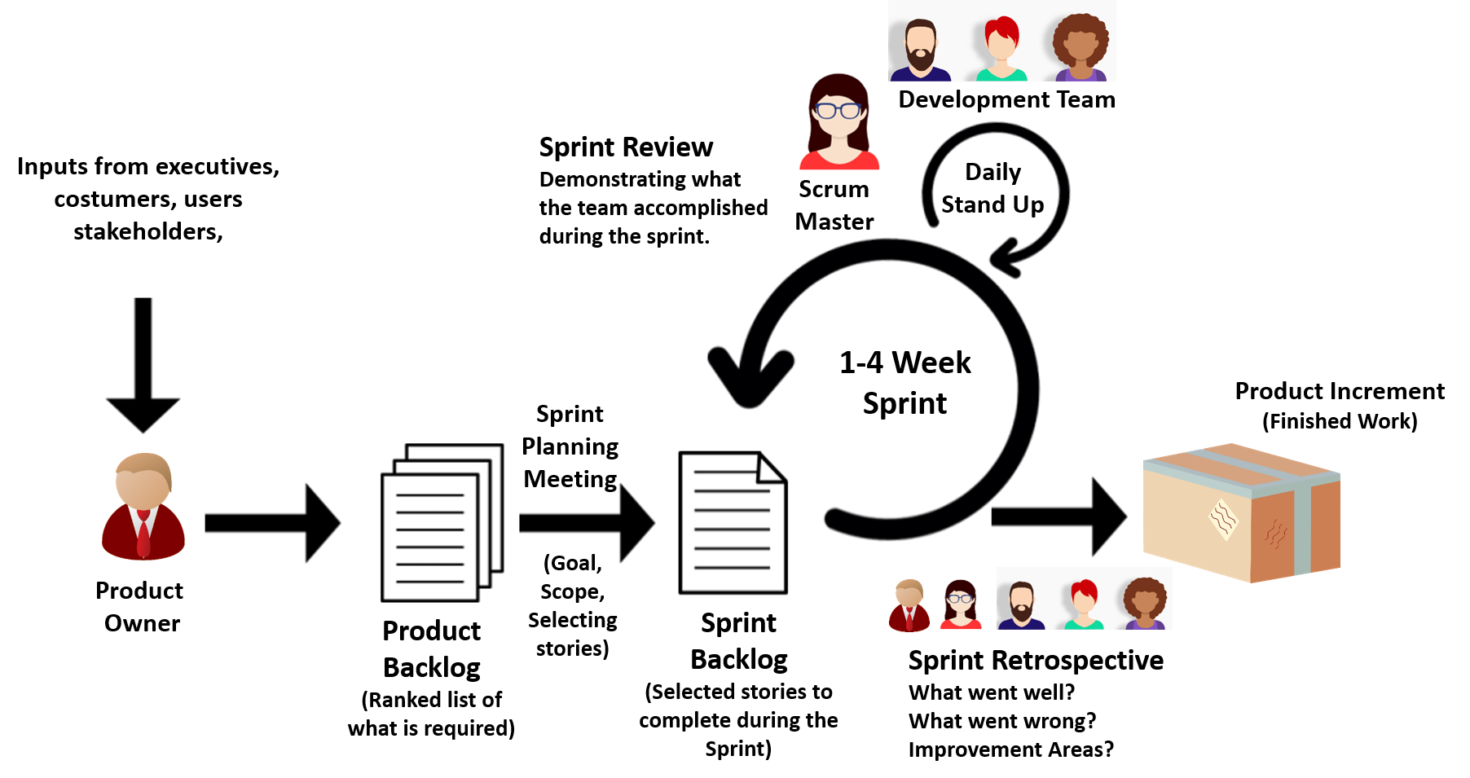
Scrum Framework
Notes:
Lets make a quick recap;
Scrum is a framework that helps teams work together. It is a framework. What Agile was, it was a mindset, a mindset and a set of values.
The Scrum framework consists of Scrum Teams and their associated roles, events, artifacts, and rules. Each component within the framework serves a specific purpose and is essential to Scrum’s success and usage.
Scrum encourages teams to learn through experience, to self-organize while working on a problem.
Makes you think about your gains and losses to improve continuously
While the Scrum we mentioned is mostly used by software development teams, its principles and lessons can be applied to any kind of teamwork.

Slide 8
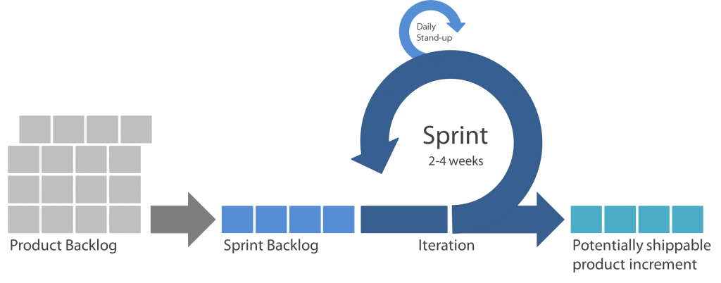
Scrum projects are divided into:
True
False
Notes:
🍐 This is a Pear Deck Multiple Choice Slide. Your current options are: A: Phases, B: Sprints, C: Milestones, D: Rolling wave planning,
🍐 To edit the type of question or choices, go back to the "Ask Students a Question" in the Pear Deck sidebar.
Scrum projects are divided into:..... sprints

Slide 9
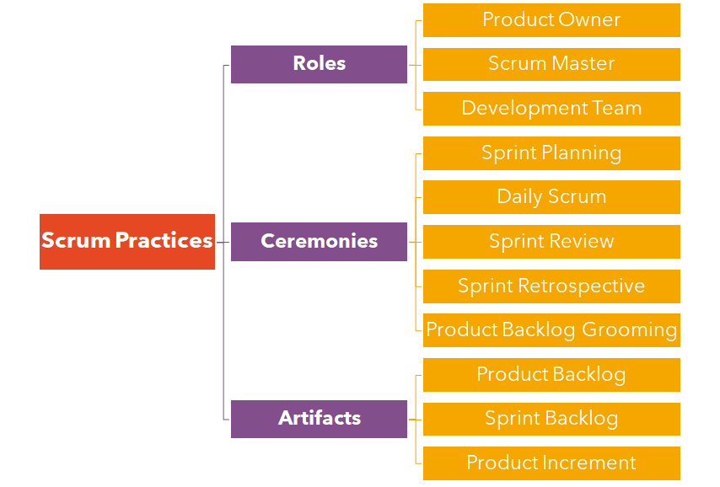



Scrum Practices
Notes:
In agile first session we have mention about this,

Slide 10
Scrum Roles
2
Notes:
who remembers scrum roles?
you can write in class chat

Slide 11



Scrum Roles
Responsible for the project’s success by defining the project vision, requirements, and priorities
Accountable to the team to remove impediments that will prevent them from achieving the goals of the Product Owner
Team comprises 3-9 people, with a mix of roles, and self-organizes to determine how to best meet the goals of the Product Owner
Product Owner
Scrum Master
Development Team
Notes:
The Scrum Team consists of a Product Owner, Development Team and a Scrum Master.
Product Owner - The person responsible for the success of the project by defining the project vision, requirements and priorities.
Scrum Master - The person responsible for removing obstacles that prevent the development team from achieving the goal.
Development Team - The team consists of 3-9 people from different roles, it organizes itself to determine how best to achieve the goals of the Product Owner.
Scrum Teams, they are the Self-organizing teams, doing the job.

Slide 12
Product Owner
Available
Decisive
Product Owner
Business Savvy
Empowered
Communicative
Notes:
Product Owner ile başlayalım.
PO ekipteki iş temsilcisidir.
Ürünün ve müşterinin paydaşlarının sesini temsil eder.
Product Owner, Geliştirme Ekibinin çalışmasından kaynaklanan ürünün değerini maksimize etmekten sorumludur.
Bunun nasıl yapıldığı organizasyonlar, Scrum Takımları ve bireyler arasında farklılık gösterebilir.
Bir Product Owner ideal olarak aşağıdaki özelliklere sahip olmalıdır:
Available : Planlama ve açıklama için her zaman kullanılabilir.
İş Deneyimi: İş veya o alan hakkında derin bir anlayışa sahip olacak.
İletişim: İyi bir dinleyicidir, paydaşlara kolayca ulaşma ve mesajı karşı tarafa uyarlama becerisine sahip olacaktır.
Yetkilendirilmiş: Karar verme yetkisine sahip olacak ve onlardan sorumlu tutulabilecek.
Kararlı / belirleyici: Ürünün yönüne karar verebilecektir..
Let's start with the product owner. P.O. is the business representative on the team.
It represents the voice of the stakeholders of the product and the customer. The Product Owner is responsible for maximizing the value of the product resulting from the Development Team's work. How this is done may differ between organizations, Scrum Teams and individuals.
A Product Owner should ideally have the following characteristics:
Available: Always available for planning and disclosure.
Work Experience: Will have a deep understanding of the job or that area.
Communication: It is a good listener, it will have the ability to easily reach stakeholders and adapt the message to the other party.
Empowered: Will have the power to make decisions and can be held responsible for them.
Decisive: Will be able to decide on the direction of the product.

Slide 13
Scrum Master
The Scrum Master is responsible for promoting and supporting Scrum
Responsible
Committed
Scrum Master
Humble
Influential
Collaborative
Knowledgeable
Notes:
Şimdi, ekibin bu taleplere nasıl ayak uydurabileceğini merak ediyorsanız, yalnız değilsiniz.
Scrumın kurucuları, “Product Owner” rolüne karşı denge ihtiyacının farkındadır.
Böylece bir usta rolü yarattılar.
Scrum master ekibi korur ve süreci korur.
Scrum Masters, herkesin Scrum teorisini, uygulamalarını, kurallarını ve değerlerini anlamasına yardımcı olarak bu sorumlulukları yerine getirir.
İnsanların talepleri ile ekibin ihtiyaçları arasında denge kurarlar.
Bu rol, ekiplerin sürdürülebilir bir seviyede performans göstermesini sağlayan ilk emniyet supabıdır.
Bitiş çizgisine ulaşmadan önce yanmalarını istemiyoruz.
Dolayısıyla Scrum Master'ların ideal olarak şunlara sahip olması gerekir:
Sorumlu: Ekibi etkinleştirmek ve ekip çıktısını en üst düzeye çıkarmak
Mütevazı: Takımın egoya izin vermeden zafere ulaşmasını sağlar
İşbirlikçi: Takımda bir işbirliği kültürü yaratır
Bağlılık: tam zamanlı Scrum Masters olmasalar bile takıma %100 bağlılık gösterin
Etkili, Yetkisiz etki yapabilmek
Bilgili: Scrum uzmanı ve teknik çevre bilgisi.
Now if you're wondering how on earth the team can keep up with these demands you're not alone.
The founders of scrum recognises the need for counter-balance to the “product owner” role.
So they created a role of master.
the scrum master protects the team and protects the process.
Scrum Masters fulfill these responsibilities by helping everyone understand Scrum theory, practices, rules, and values.
They balance the demands of the people against the needs of the team.
This role is the first safety valve to ensure that teams are performing to a sustainable level. We don't want them to get burned out before they reach the finish line.
So Scrum Masters should ideally have:
Responsible: Activating the team and maximizing team output
Humble: Allows the team to achieve victory without letting the ego
Collaborative: Creates a culture of collaboration in the team
Commitment: show 100% commitment to the team, even if they are not full-time Scrum Masters
Influential, said: Being able to make an impact without authority
Knowledgeable: Scrum expert and technical environmental knowledge

Slide 14


Development Team
The Development Team consists of professionals who do the work of delivering a potentially releasable Increment of “Done” product at the end of each Sprint.
Development Team
Product Increment
Each Sprint
Notes:
Geliştirme Ekibi,
her Sprint'in (yineleme) sonunda "Bitti" tanımını karşılayan, ürünün potansiyel olarak serbest bırakılabilir bir bölümünü teslim etmekten sorumlu profesyonellerden oluşur.
Sprint İncelemesinde "Bitti" tanımını karşılayan bir ürün parçası gereklidir.
Ürün Parçasını yalnızca Geliştirme Ekibinin üyeleri geliştirir.
Geliştirme Ekipleri, kendi çalışmalarını organize etmek ve yönetmek için kuruluş tarafından kurulan ve yetkilendirilen ekiplerdir.
Ortaya çıkan sinerji, Geliştirme Ekibinin genel verimliliğini ve etkinliğini en üst düzeye çıkarır.
The Development Team consists of professionals who are responsible for delivering a potentially releasable part of the product that meets the definition of "Done" at the end of each Sprint (iteration).
A piece of product that meets the definition of "Done" in the Sprint Review is required. Only members of the Development Team develop the Increment.
Development Teams are teams established and empowered by the organization to organize and manage their own work. The resulting synergy maximizes the Development Team's overall efficiency and effectiveness.

Slide 15

What is the role of the Scrum Master?
True
False
Notes:
🍐 This is a Pear Deck Multiple Choice Slide. Your current options are: A: Dictates the development team how to do things, B: Orders the items in the Product Backlog to best achieve goals and missions, C: Serves the development team and shields them from any distractions,
🍐 To edit the type of question or choices, go back to the "Ask Students a Question" in the Pear Deck sidebar.
What is the role of the Scrum Master?
maybe you can say also B is true but the point is scrum master does not order, maybe we can say just guide and follow the process.
so the answer is C.

Slide 16
Epic, User Story and Task
3
Notes:
Now here comes the today’s topics.

Slide 17
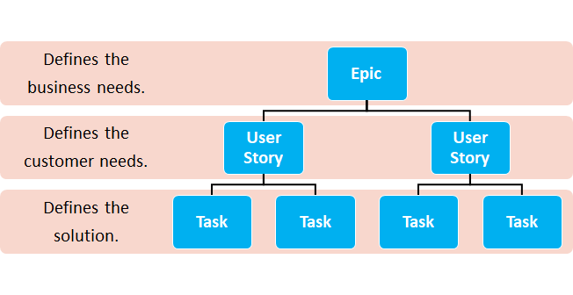
Epic, User Story and Task
Notes:
The three basic terms used in Scrum projects are Epic, User Story and Task. To fully understand a scrum project, it is necessary to understand what these concepts are. There is hierarchy among these concepts.
Epic defines business needs.
User Story defines customer needs.
Task is what needs to be done to meet customer needs.

Slide 18

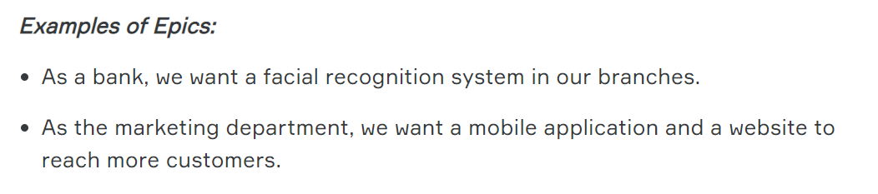
Epic
Big chunk of work.
Few lines of description.
More than one sprint to complete.
Notes:
Epic is a great user story that cannot be finished and delivered in a single iteration.
It can contain multiple user stories. So an epic is big enough to be broken down into smaller user stories.
Think about a movie about some heroes. There are many incidents happening in the movie so we call it an epic film.
The whole movie is called epic. And the incidents in the movie are stories.
In fact, there is no standard notation to represent Epics. Some teams use familiar user story formats.
Some teams represent the epics with a short phrase.

Slide 19







User Story
Customers
USER STORY
Users
Notes:
A user story is an informal, general explanation of a software feature written from the perspective of the end user.
Software helps people to do things.
a customer or user wants a software team to create an application , because they want to do something that they cannot do, or to do it faster or better.
The most effective way to ensure that the team is building the right thing for the customer
is to keep these needs in mind during the development process and record them from the user perspective.
User story is a software system requirement, expressed in a few short sentences using non-technical language.
Actually each user story is one of function of the software.
and they are something the team can commit to finish within a one or two-week sprint.

Slide 20


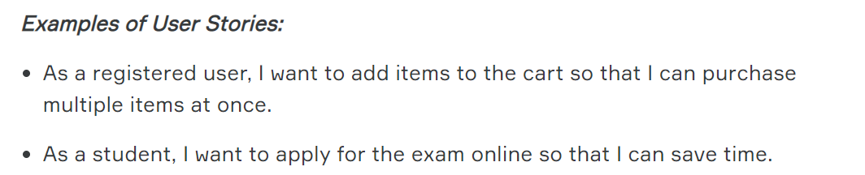
User Story
User Needs.
Few lines of description.
Deliver during a sprint.
Notes:
Shortly;
User stories explain how the user want to use the software in a few sentences.
In expressions starting with the <As a> structure, the role played by the user while using the software is highlighted.
In expressions starting with the <I want> structure, the action the user wants to perform in the software is highlighted.
Expressions starting with the <So that> structure tell why the user wants the feature.

Slide 21

Task
Represents a technical activity
Description of individual work item
Created by anyone
Examples of Tasks:
Redesign a single web page
Create a new logo
Perform usability testing
Notes:
Tasks are decomposed parts of a story that get into HOW the story will be completed.
Tasks are usually defined by the people doing the work (developers, QA, etc),
whereas stories and epics are generally created by the customer or the product owner on behalf of the customer.
Tasks are the small functional parts of the user strories

Slide 22
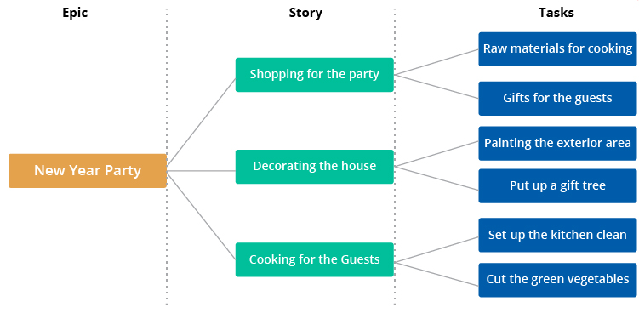
Epic, User Story and Task
Notes:
Here is a sample ;
I will give a party. This is epic, I can broke down this issue into small pieces to prepare it.
There are 3 stories in this example.
First one;
As a party owner, I should go to shopping to be ready for the party.
And the tasks for the first user story are; I will buy raw materials for cooking and I will buy gift for the guests.
Second one;
As a party owner I should decorate the house
tasks are :
and the third one:
As a party owner I should prepare meals and make the cooking
The tasks are:

Slide 23





Which project management tool are you familiar with?
Notes:
🍐 This is a Pear Deck Multiple Choice Slide. Your current options are: A: Not any, B: ClickUp, C: Jira, D: Trello, E: monday.com, F: All of them,
🍐 To edit the type of question or choices, go back to the "Ask Students a Question" in the Pear Deck sidebar.
Which project management tool are you familiar with?

Slide 24

Estimation
T-Shirt Sizing
1, 2, 3, 5, 8, 13, 21
Story Points
Notes:
When it comes to project management, the big question is always “How long will this take?”.
making accurate delivery forecast is the best way for customer satisfaction.
In scrum, The estimation is about the user strories. And it is a relative scoring.
Estimation is not easy actually.. For software developers, it's among the most difficult aspects of the job.
Involving everyone (developers, designers, testers, deployers... everyone) on the team is key. Each team member brings a different perspective on the product
The story point makes the team to focus on the size for each user story.
The purpose of planning is to estimate the exact completion dates of the stories.
The team assigns a point value to each story depending on how big it is.
One way teams can estimate is to split stories into T-shirt sizes and assign a point value to each size.
For example, they may decide to use 1 point for extra small features, 2 points for small features and 3 points for medium features, 4 points for large and 5 points for extra large features.
After deciding on a scale, they must decide which category each story fits into.
Some teams use the Fibonacci sequence (1, 2, 3, 5, 8, 13, 21 ...) for story point because they think it's more realistic for larger features.

Slide 25
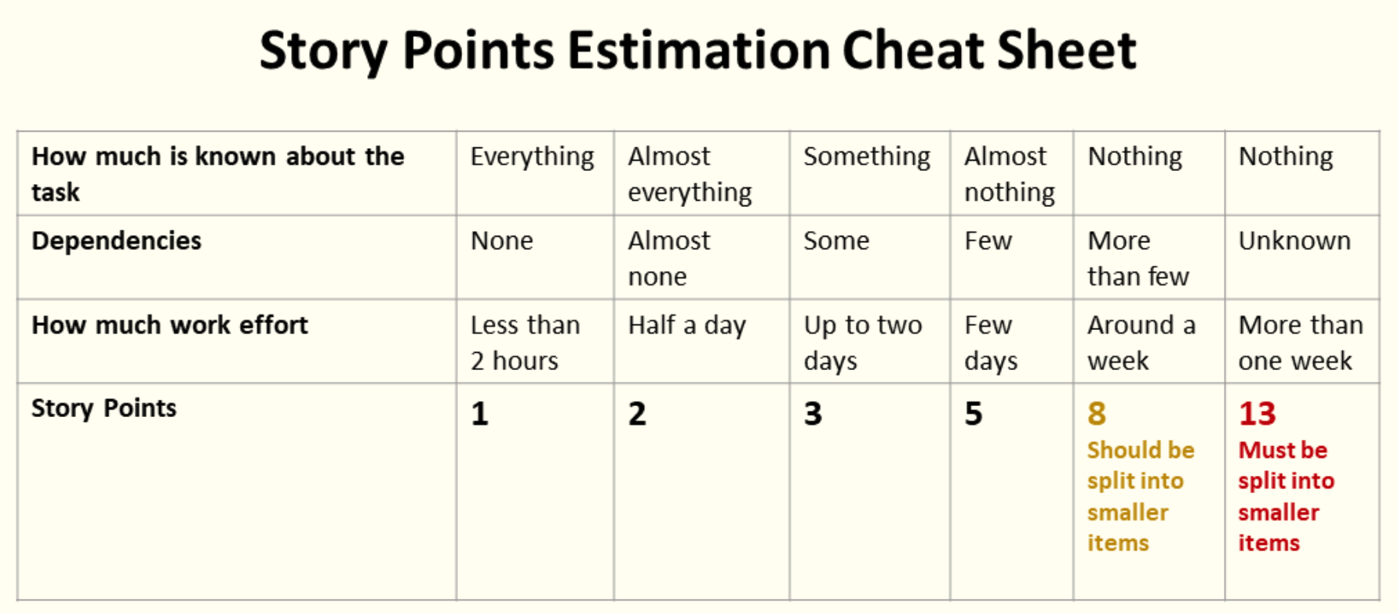
Estimation
Notes:
In this slide there is a sample story point estimation cheat sheet
For example your team always uses flask framework for deployment but this time it needs django framework. You don’t have enough experience and you don’t know dependencies so you can give it to 8 or maybe 13 points.

Slide 26
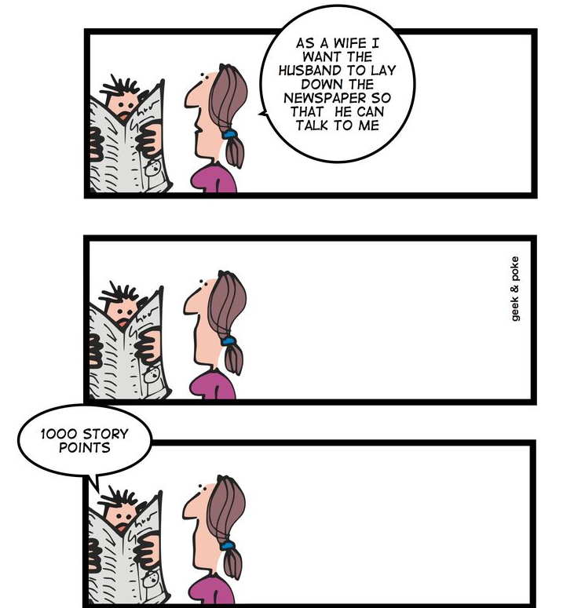
Which one is NOT relative estimation of story?
Notes:
🍐 This is a Pear Deck Multiple Choice Slide. Your current options are: A: Minutes and Hours, B: T-shirt Sizes, C: Story Points,
🍐 To edit the type of question or choices, go back to the "Ask Students a Question" in the Pear Deck sidebar.
Which one is NOT relative estimation of story?
The first rule about sizing user stories is, never ever (directly or indirectly) size stories in any unit of time.
The second rule is to always use relative sizing like tshirt sizes, small-medium large or
using story points like fabionacchi numbers

Slide 27
Scrum Artifacts
4

Slide 28
Main Scrum Artifacts
3
1
2
Notes:
The term artifact is often associated with archaeological ruins from ancient times.
Yet in software development, the term artifact refers to key information needed during the development of a product.
Agile scrum artifacts are information that a scrum team and stakeholders use to detail the product
being developed,
actions to produce it, and
the actions performed during the project.
The main agile scrum artifacts are product backlog, sprint backlog, and increments.

Slide 29
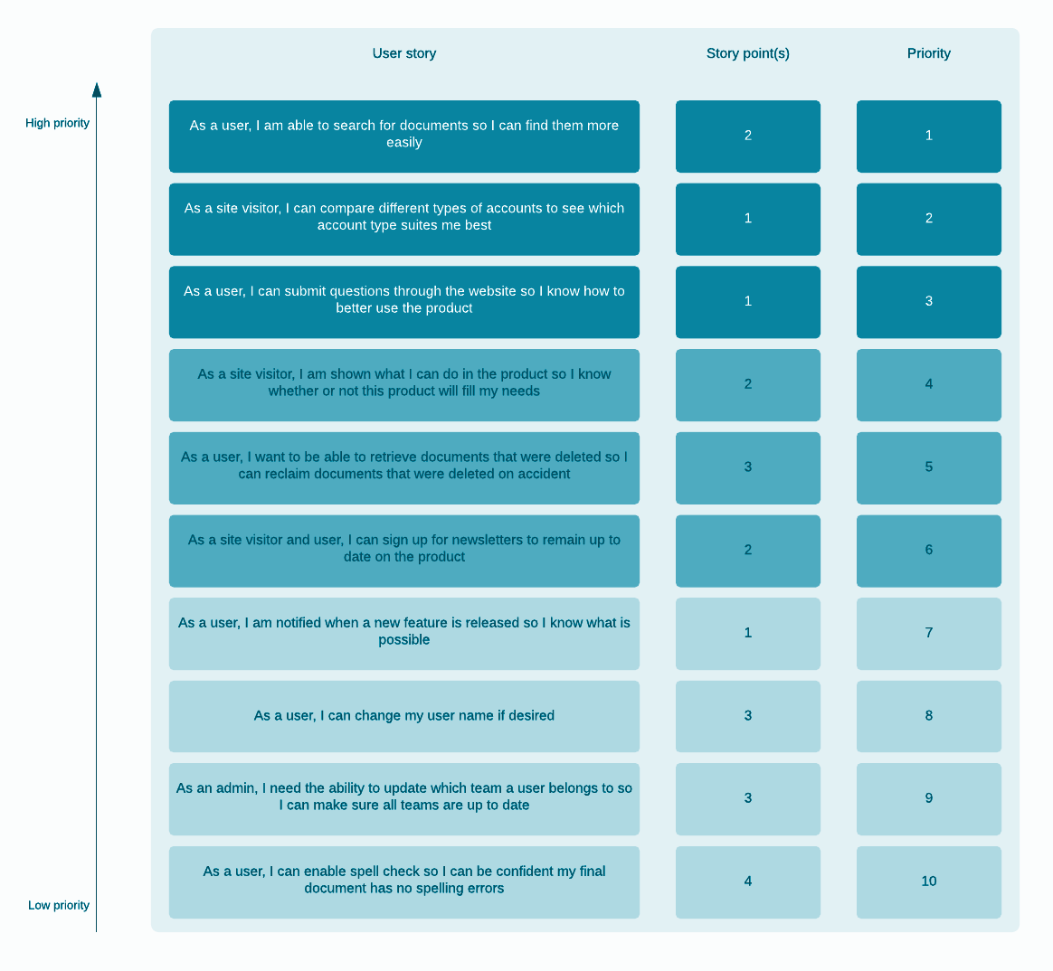
Product Backlog
Ordered list of everything
List of prioritized items
Product Owner is responsible
Dynamic
Should be refined regularly
Notes:
The product backlog is a list of new features, enhancements, bug fixes, tasks, or work requirements needed to build a product.
It’s compiled from input sources like customer support, market demands, and general business analysis.
The product backlog is a “live” artifact in that it is updated on-demand as new information is available.
The Product Owner is responsible for the content, availability and ranking of the Product Backlog
.
Product Backlog items have a description, order, (size) estimate and value.

Slide 30
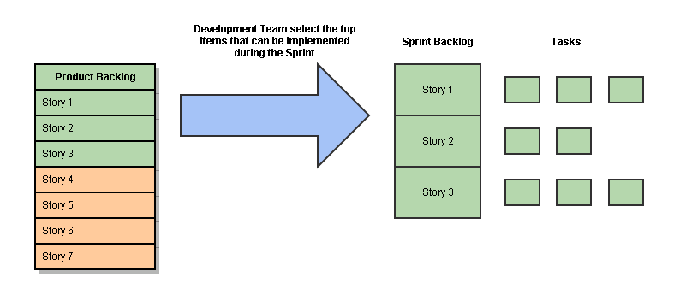
Sprint Backlog
The set of Product Backlog items selected for the Sprint
A plan for delivering the product Increment and realizing Sprint Goal
Highly visible, real-time picture of the work
Notes:
The Sprint Backlog is a planning for the next sprint.
It includes the Product Backlog items
selected for the Sprint,
The Sprint Backlog includes all the work the Development Team to achieve the Sprint Goal.
Only the Development Team can change the Sprint Backlog during the Sprint.
The Sprint Backlog is a real-time picture of the work that the Development Team plans to accomplish during the Sprint,
and it belongs exclusively to the Development Team.
The Development Team tracks the total remaining work, at least in each Daily Scrum, to see how close it is to achieving the Sprint Goal.

Slide 31
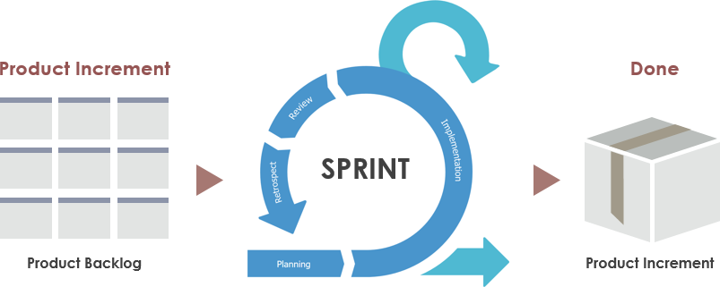
Product Increment
The sum of all the Product Backlog items completed during a Sprint and the value of the increments of all previous Sprints.
At the end of a Sprint, the new Increment must be “Done”.
The increment must be in useable condition regardless of whether the Product Owner decides to release it.
Notes:
Increment is the sum of the values ​​of the Product Backlog items completed during a Sprint and the Product Parts of all past Sprints.
At the end of the Sprint, the new Increment must be "Done",
meaning it must be available and meet the Scrum Team's definition of "Done".
The Increment is a step towards the vision or goal. Whether the Product Owner decides to release - it must be in a usable state.

Slide 32

Who prioritizes the product backlog items?
Notes:
🍐 This is a Pear Deck Multiple Choice Slide. Your current options are: A: Product Owner, B: Development Team, C: Analyst, D: Stakeholder,
🍐 To edit the type of question or choices, go back to the "Ask Students a Question" in the Pear Deck sidebar.
Who prioritizes the product backlog items?
In real Scrum, the Product Owner is the one that prioritizes the product backlog.
However, it is the Development Team that decides
how many of the prioritized stories it can fit in the upcoming Sprint.

Slide 33
Scrum Ceremonies
5

Slide 34
Scrum Meetings
Sprint Planning
Determine what work will be completed in the upcoming sprint based on the backlog.
Daily Standup
A 15-minute meeting for team to share what they did yesterday, what they’ll do today, and blockers.
Sprint Review
Share work completed in
the sprint and get
feedback from
stakeholders.
Retrospective
Reflect on what did/
did not go well in the previous sprint and identify improvements.
Notes:
In sprint planning, Based on the Product Backlog, it is determined which ones will be completed in the following sprint.
A daily stand-up meeting is a short, time-boxed team status check, held every day, usually at a set time.
The Scrum framework calls the daily stand-up a ‘Daily Scrum’.
Sprint Review, discussing the work completed in Sprint and get feedback from stakeholders.
Retrospective, Think about what went well / did not in the previous sprint and identify improvements.
there is also a grooming meeting;
Backlog grooming, also referred to as backlog refinement or story time.
Grooming (or refinement) is a meeting of the Scrum team in which the product backlog items are discussed and
the next sprint planning is prepared.
It is like a preparation for sprint planning.
not so common.

Slide 35
Sprint Planning

Slide 36
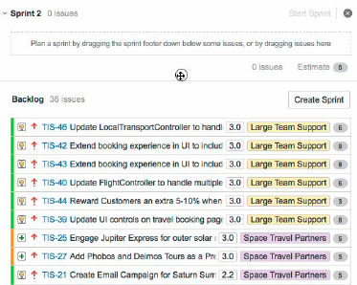
Sprint Planning
Determine what work will be completed in the upcoming sprint based on the backlog.
Ensure all user stories in the backlog are ready for development.
Assign points to user stories to indicate the level of effort.
Agree on what work will be done and by whom.
Notes:
Lets see one by one;
The work to be performed in the Sprint is planned at the Sprint Planning. This plan is created by the collaborative work of the entire Scrum Team.
Sprint Planning is time-boxed to a maximum of eight hours for a one-month Sprint. For shorter Sprints, the event is usually shorter. The Scrum Master ensures that the event takes place and that attendants understand its purpose. The Scrum Master teaches the Scrum Team to keep it within the time-box.
Sprint Planning answers the following:
• Topic One: What can be delivered in the Increment resulting from the upcoming Sprint? What can be done this Sprint?
• Topic Two: How will the work needed to deliver the Increment be achieved? How will the chosen work get done?
By the end of the Sprint Planning, the Development Team should be able to explain to the Product Owner and Scrum Master how it intends to work as a self-organizing team to accomplish the Sprint Goal and create the anticipated Increment.

Slide 37
Daily Standup

Slide 38





Daily Standup
A 15-minute meeting for team to share what they did yesterday, what they’ll do today, and blockers.
15 minutes max: Additional conversations can happen after standup.
What did I do yesterday?
What will I do today?
What blockers do I have?
Happen on a daily basis during a sprint.
Everyone answers three questions.
Notes:
The Daily Scrum is a 15-minute time-boxed event for the Development Team. The Daily Scrum is held every day of the Sprint.
At it, the Development Team plans work for the next 24 hours.
This optimizes team collaboration and performance by inspecting the work since the last Daily Scrum and forecasting upcoming Sprint work. The Daily Scrum is held at the same time and place each day to reduce complexity.
The Development Team uses the Daily Scrum to inspect progress toward the Sprint Goal and to inspect how progress is trending toward completing the work in the Sprint Backlog.
The Daily Scrum optimizes the probability that the Development Team will meet the Sprint Goal. Every day, the Development Team should understand how it intends to work together as a self-organizing team to accomplish the Sprint Goal and create the anticipated Increment by the end of the Sprint.
The structure of the meeting is set by the Development Team and can be conducted in different ways if it focuses on progress toward the Sprint Goal.

Slide 39
Daily Standup
A 15-minute meeting for team to share what they did yesterday, what they’ll do today, and blockers.
15 minutes max: Additional conversations can happen after standup.
What did I do yesterday?
What will I do today?
What blockers do I have?
Happen on a daily basis during a sprint.
Everyone answers three questions.
Notes:
Some Development Teams will use questions, some will be more discussion based. Here is an example of what might be used:
• What did I do yesterday that helped the Development Team meet the Sprint Goal?
• What will I do today to help the Development Team meet the Sprint Goal?
• Do I see any impediment that prevents me or the Development Team from meeting the Sprint Goal?
The Development Team or team members often meet immediately after the Daily Scrum for detailed discussions, or to adapt, or replan, the rest of the Sprint’s work. The Scrum Master ensures that the Development Team has the meeting, but the Development Team is responsible for conducting the Daily Scrum.
The Scrum Master teaches the Development Team to keep the Daily Scrum within the 15-minute time-box.
The Daily Scrum is an internal meeting for the Development Team.
If others are present, the Scrum Master ensures that they do not disrupt the meeting.
Daily Scrums improve communications, eliminate other meetings, identify impediments to development for removal, highlight and promote quick decision-making, and improve the Development Team’s level of knowledge. This is a key inspect and adapt meeting.

Slide 40
Who should necessarily attend the Daily Standup meeting?
Notes:
🍐 This is a Pear Deck Multiple Choice Slide. Your current options are: A: Development Team, B: Scrum Master, C: Development Team and Product Owner,
🍐 To edit the type of question or choices, go back to the "Ask Students a Question" in the Pear Deck sidebar.
Who should necessarily attend the Daily Standup meeting?
The Development Team is necessarily required to attend the Daily Standup meeting every day. Anyone else who wishes to attend the meeting is very much welcome but it is not mandatory to attend it. Other than the Development Team, whoever is attending the meeting is not allowed to give updates or participate

Slide 41
Sprint Review

Slide 42

Sprint Review
Share work completed in the sprint and get
feedback from stakeholders.
Team members share the work that they completed in the sprint.
Stakeholders share feedback that’s incorporated into future sprints.
Celebrate progress and achievements.
Notes:
A Sprint Review is held at the end of the Sprint to inspect the Increment and adapt the Product Backlog if needed.
• Attendees include the Scrum Team and key stakeholders invited by the Product Owner;
During the Sprint Review, the Scrum Team and stakeholders collaborate about what was done in the Sprint.
Based on that and any changes to the Product Backlog during the Sprint, attendees collaborate on the next things that could be done to optimize value.
This is an informal meeting, not a status meeting,
This is at most a four-hour meeting for one-month Sprints. For shorter Sprints, the event is usually shorter.
The Scrum Master ensures that the event takes place and that attendees understand its purpose.

Slide 43
Sprint Review
Share work completed in the sprint and get
feedback from stakeholders.
Team members share the work that they completed in the sprint.
Stakeholders share feedback that’s incorporated into future sprints.
Celebrate progress and achievements.
Notes:
During the Sprint Review ;
• The Product Owner explains what Product Backlog items have been “Done” and what has not been “Done”;
• The Development Team discusses what went well during the Sprint, what problems it ran into, and how those problems were solved;
• The Development Team demonstrates the work that it has “Done” in the sprint and answers questions about the Increment;
• The entire group collaborates on what to do next, so that the Sprint Review provides valuable input to subsequent Sprint Planning;
• Review of how the marketplace or potential use of the product might have changed what is the most valuable thing to do next; and,
• Review of the timeline, budget, potential capabilities, and marketplace for the next anticipated releases of functionality or capability of the product.
The result of the Sprint Review is a revised Product Backlog that defines the probable Product Backlog items for the next Sprint. The Product Backlog may also be adjusted overall to meet new opportunities.

Slide 44
Sprint Retrospective

Slide 45


Sprint Retrospective
Reflect on what did/did not go well in the previous sprint and identify improvements.
Opportunity for the Scrum Team to inspect itself.
What went well?
What didn’t go well?
What can we do differently?
Learnings are incorporated into future sprints.
Make it more effective and enjoyable for the next Sprint.
Notes:
The Sprint Retrospective is an opportunity for the Scrum Team to inspect itself and create a plan for improvements to be enacted during the next Sprint.
The Sprint Retrospective occurs after the Sprint Review and prior to the next Sprint Planning.
This is at most a three-hour meeting for one-month Sprints. For shorter Sprints, the event is usually shorter. The Scrum Master ensures that the event takes place and that attendants understand its purpose.
The Scrum Master ensures that the meeting is positive and productive.
The Scrum Master teaches all to keep it within the time-box. The Scrum Master participates as a peer team member in the meeting from the accountability over the Scrum process.

Slide 46
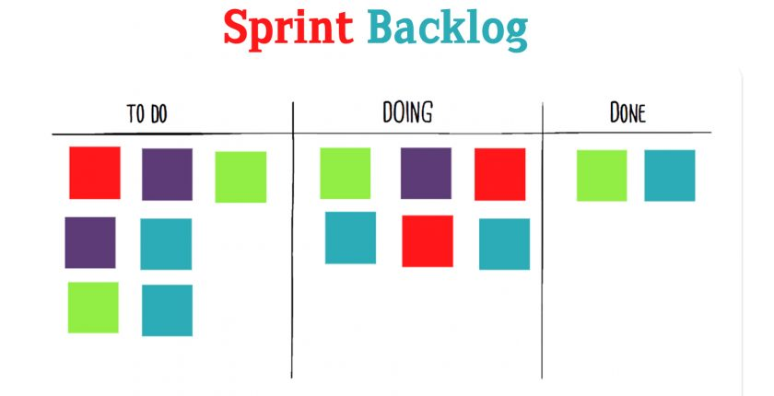
What happens when all the Sprint Items cannot be completed?
Notes:
🍐 This is a Pear Deck Multiple Choice Slide. Your current options are: A: The Sprint should be extended, B: The Sprint ends with the done items, C: The Sprint should be canceled,
🍐 To edit the type of question or choices, go back to the "Ask Students a Question" in the Pear Deck sidebar.
What happens when all the Sprint Items cannot be completed?
In a case where the team is unable to complete all the Sprint Backlog items, nothing happens.
The Sprint ends on the stipulated date with the completed items.
The Development Team demonstrates the completed items in the Sprint Review meeting
The uncompleted items are moved back to the Product Backlog and are again prioritized from there.

Slide 47
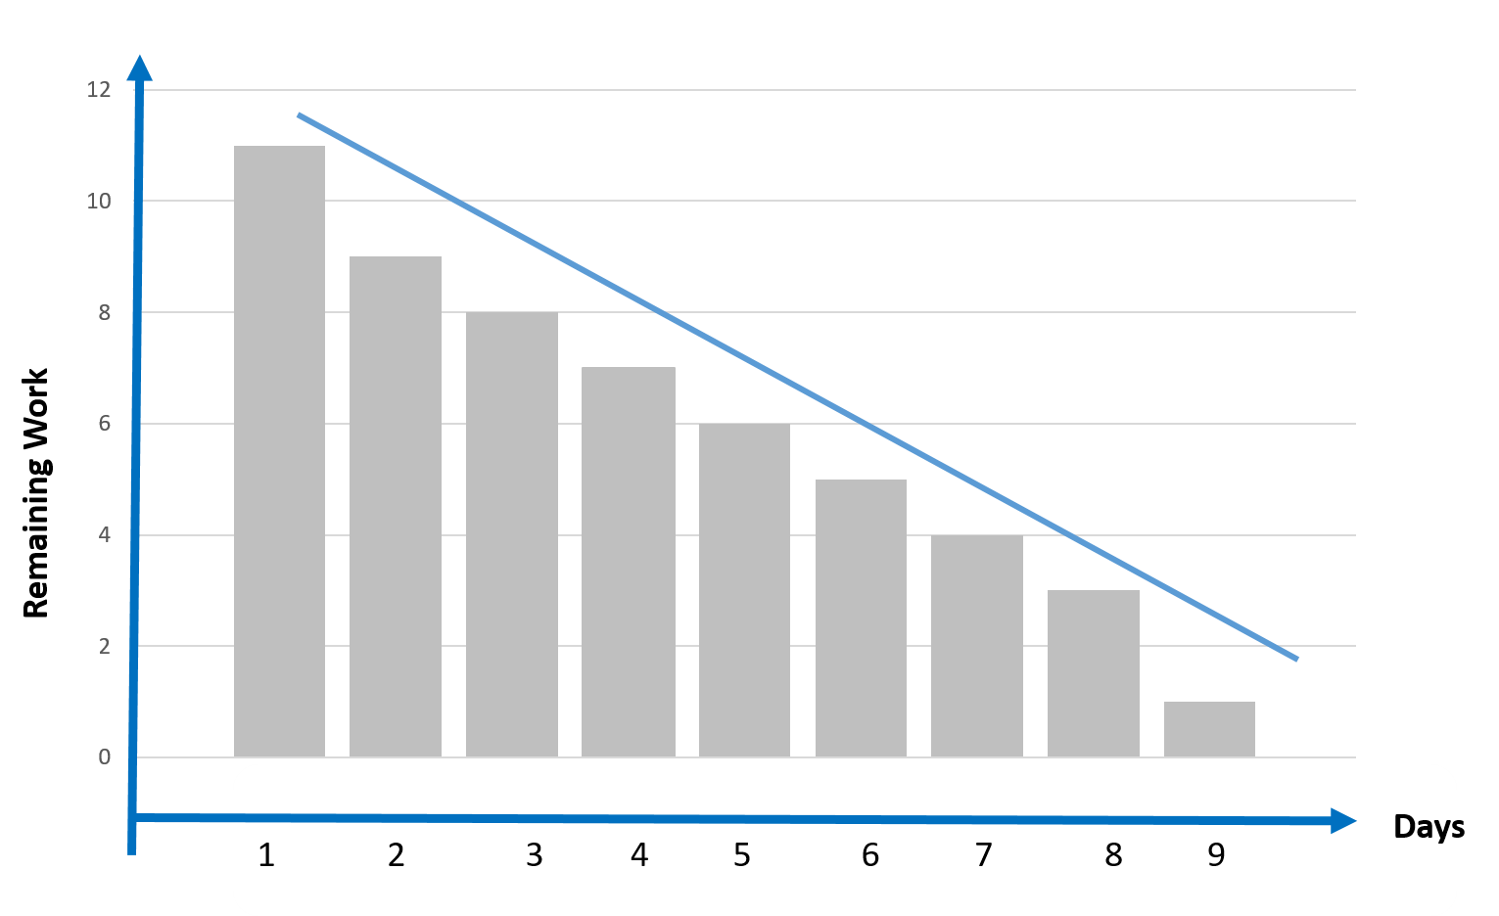
Burndown Chart
Graphical demonstration of remaining work versus time.
Notes:
A burndown chart is a graphical demonstration of work left to do versus time.
In the chart, the vertical axis usually represents the remaining work while the horizontal axis represents the time or days.
It is useful for forecasting when all of the work will be completed.
A simple example of a burndown chart is given in the slide
The burndown chart provides a day-by-day measure of the work that remains in a given sprint or release. The slope of the graph, or burndown velocity, is calculated by comparing the number of hours worked to the original project estimation and shows the average rate of productivity for each day
The Rules of Scrum: Your Product Owner creates and maintains the team's Product or Release burndown chart. The Product burndown chart tracks the amount of work remaining in the Product Backlog Sprint-by-Sprint. This burndown chart is updated every Sprint and is visible to the Scrum Team and its stakeholders.

Slide 48
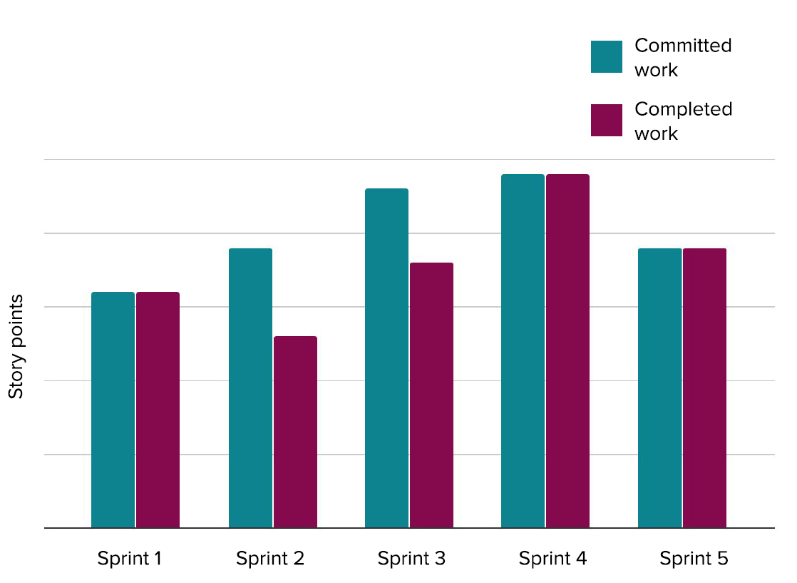
Velocity Chart
How much work is completed in each sprint.
Notes:
The Velocity Chart shows the amount of value delivered in each sprint, enabling you to predict the amount of work the team can get done in future sprints. It is useful during your sprint planning meetings, to help you decide how much work you can feasibly commit to.
The y-axis displays the statistic used for estimating stories. In the example above, the team is using story points. The x-axis displays the sprints completed by the team. The gray bar for each sprint shows the total estimate of all issues in the sprint when it begins. The green bar in each sprint shows the total completed estimates when the sprint ends.
Keeping track of the velocity is the responsibility of the scrum master.
At the end of each sprint demo, the scrum master should calculate the number of points that were estimated for the stories that were accepted as done during that sprint.
This number should be added as a data point on the velocity chart for that sprint.

Slide 49
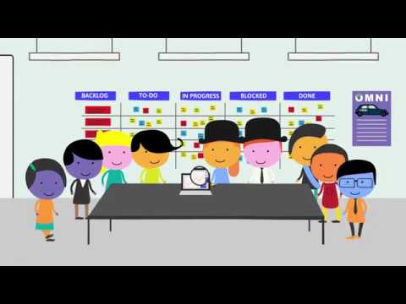
A Brief Overview

Slide 50


Slide 51
KANBAN

Slide 52
KANBAN
Kanban Overview
Kanban Board
Principles of Kanban
Practices of Kanban
Kanban vs Scrum

Slide 53
Kanban Overview
1

Slide 54
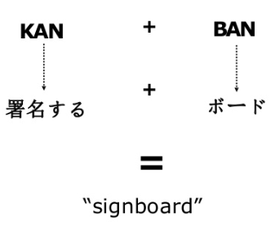
What is Kanban?
Kanban is a fusion word with Japanese roots. The word “kan” means visual, and the meaning of the word “ban” is card.
Notes:
Kanban is another popular methodology for implementing the agile system in the business.
The word "kanban" is in Japanese and can be translated as "the card you can see" or "signboard".
As the name implies, it is a visual framework used to implement agile and shows what to produce, when to produce it, and how much to produce.
Kanban focuses on visualizing the workflow process. The primary goal of kanban is to identify potential flaws in the process and to correct them to ensure that works progress at the desired pace.
in many cases Kanban has proven to be an excellent method / catalyst for this.

Slide 55
The word kanban is Japanese and roughly translated means “card you can see.”
Notes:
🍐 This is a Pear Deck Multiple Choice Slide. Your current options are: A: True, B: False,
🍐 To edit the type of question or choices, go back to the "Ask Students a Question" in the Pear Deck sidebar.
The word kanban is Japanese and roughly translated means “card you can see.”

Slide 56
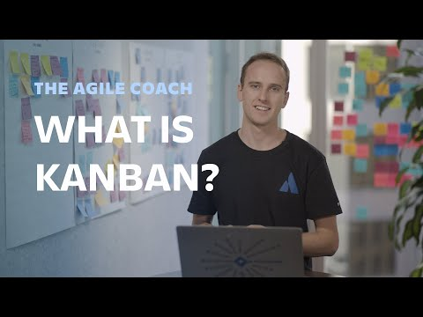
What is Kanban?

Slide 57
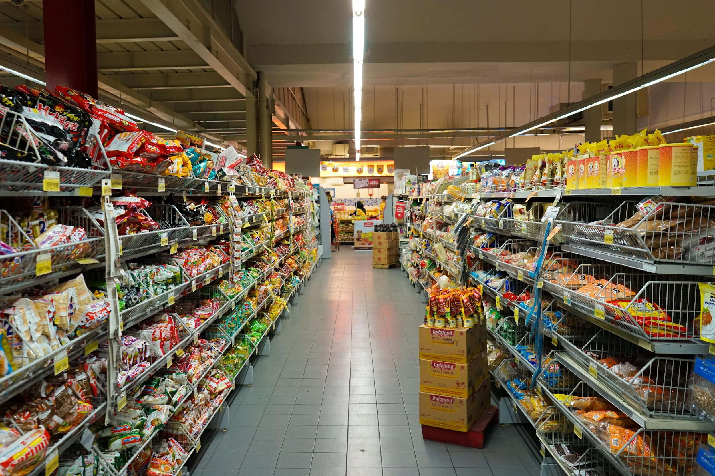
A Brief History on Kanban
Dates back to the 1940s
Toyota updated its production method based on the model that supermarkets use to manage stocks on shelves
To monitor capacity levels in real-time, the company started using a card called "kanban" between different production teams
Notes:
Kanban's story dates back to the 1940s. During these years, Toyota updated its production method based on the model that supermarkets use to manage stocks on shelves.
Toyota adopted the system used by the supermarket. To monitor capacity levels in real-time, the company started using a card called "kanban" between different production teams.
When a bin of material used on the production line was unloaded, a kanban was sent to the warehouse, explaining which material was required. With the new materials provided by the warehouse, production continued without interruption, and the process monitored continuously.
The kanban method controls the entire chain from production to the end consumer. In this way, it prevents both the failure of supply and the over-stocking of the goods at various stages of the production process. This requires continuous monitoring of the process.

Slide 58

Kanban in Software Development
In 2004, David J. Anderson introduced the idea of using the kanban concept for software development
In 2010 he wrote a book named "Kanban: Successfully Evolutionary Change for your Technology Business ”
Kanban's use in software development begins after these attempts by David J. Anderson.
Notes:
Although its story dates back to the 1940s, the application of kanban in the world of computer technology is a relatively new topic.
In 2004, David J. Anderson introduced the idea of using the concept of kanban for software development, and in 2010 he wrote a book called
"Kanban: Successful Evolutionary Change for Your Technology Business."
Kanban's use in software development begins after David J. Anderson's attempts.

Slide 59
Kanban Board
2
Notes:
Kanban board means everything for kanban.

Slide 60
Kanban Board
To Do
Ongoing
Review
Done
Notes:
A Kanban board is a tool for workflow visualization.
Visualizing your workflow and tasks on a Kanban board helps you better understand your processes and gain an overview of your workload.
With this new level of transparency, you will quickly identify problematic work stages,
Kanban boards visually depict work at various stages of a process using cards to represent work items and columns to represent each stage of the process. Cards are moved from left to right to show progress and to help coordinate teams performing the work.
This is kanban board you see in the slide. It is very simple.
Now I want you to fill the board with what we in did this lesson, what we are doing, and what we will we do

Slide 61
Kanban Board
To Do
Ongoing
Review
Done
Principles of Kanban
Kanban Board
Kanban
Overview
Scrum Overview
Practices of Kanban
Notes:
Now lets compare your board with this one in the slide

Slide 62
In kanban, each stage of a project is demonstrated with a what?
Notes:
🍐 This is a Pear Deck Multiple Choice Slide. Your current options are: A: card, B: board, C: column,
🍐 To edit the type of question or choices, go back to the "Ask Students a Question" in the Pear Deck sidebar.
In kanban, each stage of a project is demonstrated with a what?
column

Slide 63
PULL SYSTEM
Kanban Board
To Do
Ongoing
Review
Done
Principles of Kanban
Scrum vs Kanban
Scrum Overview
Practices of Kanban
Kanban Board
Kanban Board
Kanban
Overview
Notes:
The aim is to categorize the work to be done here by level. It's a process from start to finish.

Slide 64
WORKFLOW
Kanban Board
To Do
Ongoing
Review
Done
Principles of Kanban
Scrum vs Kanban
Scrum Overview
Practices of Kanban
Kanban Board
Kanban
Overview
Notes:
Kanban boards can be made into walls, whiteboards or digital gadgets like Trello or Jira. There are many tools for management.
It can be different from company to company but the main concept is the same.
In our course we will show you the Jira tool. It is the most common one in the software development.

Slide 65
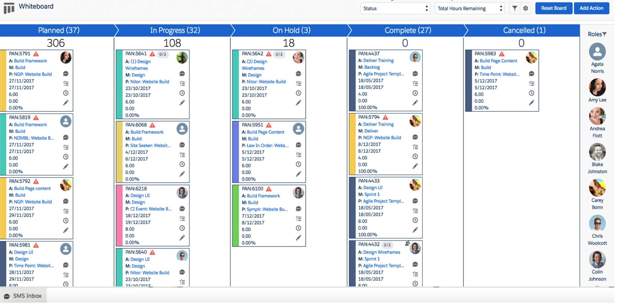
CARDS
Kanban Board
Notes:
The information contained in Kanban cards differs from organization to organization. In other words, what you put on the cards is up to you.
cards can include;
A name or very brief explanation of what the card is about.
Project name or ID, especially if there is more than one project in progress.
Beginning, ending, stages etc. Workflow dates such as.
End date.
Priority.
People working on the task.
Although the information is flexible, it should represent the task and situation at hand.

Slide 66
WIP
Kanban Board
Principles of Kanban
Scrum vs Kanban
Scrum Overview
Practices of Kanban
Kanban Board
Kanban
Overview
Notes:
The Kanban board is a perfect tool for visualizing potential problems in your process.
The logic is simple: if you see a column in which tasks arrive faster than they leave, work will start to pile up, and the problem will become visible to the whole team.
This may be caused by a temporary issue or a bottleneck in your process.
The acronym WIP stands for Work In Progress.
WIP is the number of task items that a team is currently working on.
It frames the capacity of your team's workflow at any moment. Limiting work in progress is one of the core properties of Kanban.
It allows you to manage your process in a way that creates a smooth workflow and prevents overloads.

Slide 67
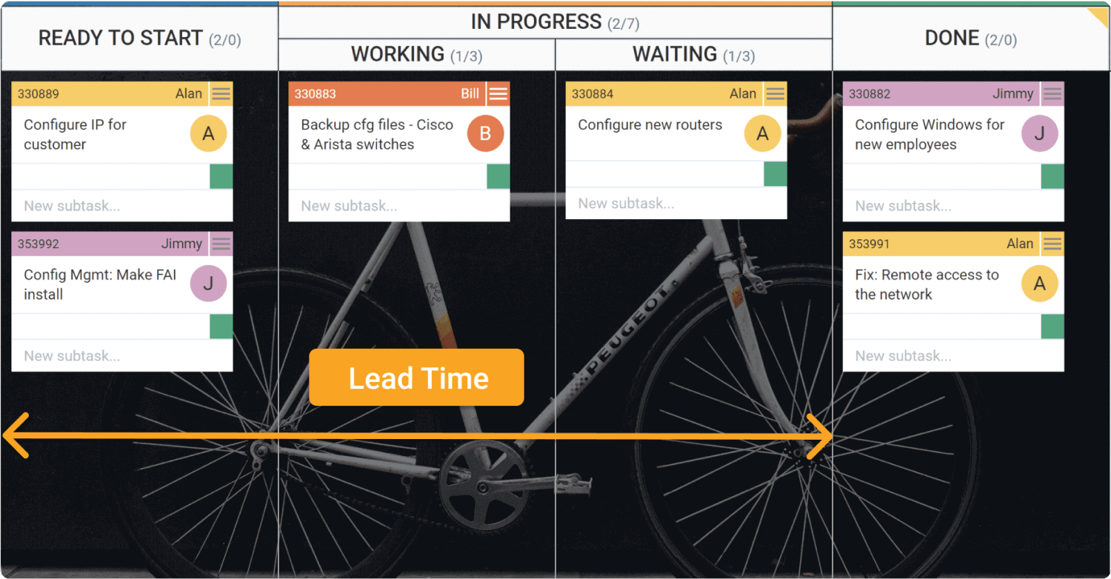
Lead Time
Notes:
Delivery time is the time between creating a task in your workflow and its last departure from the kanban board.
Kanban helps you monitor workflow, identify bottlenecks and improve flow to reduce lead time.

Slide 68
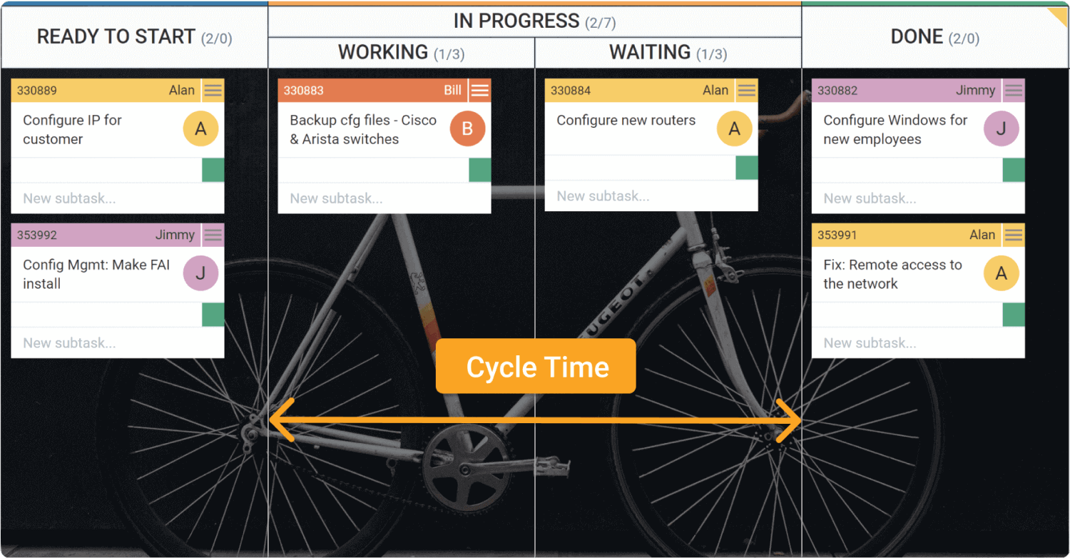
Cycle Time
Notes:
The cycle time begins the moment the new arrival enters the "ongoing" phase and someone is actually working on it.

Slide 69
It is the period between creating a task in your workflow and its final departure from the kanban board.
Notes:
🍐 This is a Pear Deck Multiple Choice Slide. Your current options are: A: Lead Time, B: Cycle Time, C: Burndown,
🍐 To edit the type of question or choices, go back to the "Ask Students a Question" in the Pear Deck sidebar.
It is the period between creating a task in your workflow and its final departure from the kanban board.

Slide 70
Principles of Kanban
3

Slide 71
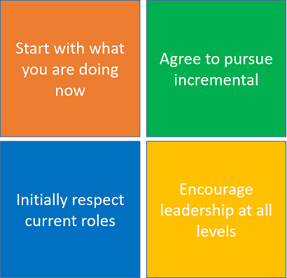




Principles of Kanban
Notes:
Kanban has adopted Four Basic Principles and Six Core Practices to manage workflow and increase efficiency. Kanban's four principles:
Now start with what you are doing: Do not instantly make changes to the existing setup or process.
Agree to maintain incremental, evolutionary change: Make small incremental changes within the team rather than major changes that could lead to resistance.
The other two principles are to respect current roles and encourage leadership

Slide 72

Start With What You Are Doing Now
First Principle
Do not make instant changes to the existing setup or process
Kanban must be directly applied to the existing workflow
Necessary changes should be made slowly and gradually
Notes:
Lets check the principles one by one
The Kanban Method does not ask you to change your process.
Kanban should be applied directly to the existing workflow. It is about the workflow.
The necessary changes should be made slowly and gradually, so the team feels comfortable.
There is no such thing as the Kanban Software Development Process or the Kanban Project Management Method.
The flexibility and simplicity of Kanban lies in the fact that a Kanban system can be mapped over existing workflows without disrupting what is already working. From there, the Kanban system will show the problems to be solved.

Slide 73

Agree to Pursue Incremental
Second Principle
Make minor incremental changes rather than major changes
Major changes lead to resistance within the team
Notes:
The organization (or team) must agree that their current circumstances warrant a gentle, evolutionary approach to improvement.
Without agreement, a slow, gentle, evolutionary, incremental approach is the right way forward then there won’t be the right environment or management support for a Kanban initiative.
The Kanban method is designed to cause minimal resistance and, therefore, encourages small continuous and evolutionary changes in the current process.

Slide 74

Initially Respect Current Roles
Third Principle
You do not need to modify your existing roles and functions that perform well
The team will coordinate and implement the necessary changes to the roles and titles
Notes:
It is likely that, what the organization currently does, has some elements that work acceptably and are worth preserving.
We must also seek to drive out fear in order to facilitate future change.
By agreeing to respect current roles, responsibilities and job titles we eliminate initial fears.
This should enable us to gain broader support for our Kanban initiative.

Slide 75

Encourage Leadership At All Levels
Fourth Principle
Constant improvement at all levels of the organization is encouraged
It is desirable that all team members produce ideas and show leadership
Notes:
Kanban offers teams and managers the ability to focus on improving the flow of value and stop focusing on who is doing what. What Kanban intends is to stop managing people and start managing the work, and for this it offers these Kanban principles and very simple practices so that all team members learn to understand the current situation and see opportunities of improvement
As Kanban extends to understand more stages of the flow of value, or more layers of the organization, that ability to make decisions and improve the organization extends to all levels.
This Kanban principle reminds us that leadership comes from the daily actions of frontline people.
It is important that everyone fosters a continuous improvement mentality to achieve optimal performance at the team / department / company level. Continuous improvement is everyone’s responsibility.

Slide 76
Practices of Kanban
4

Slide 77

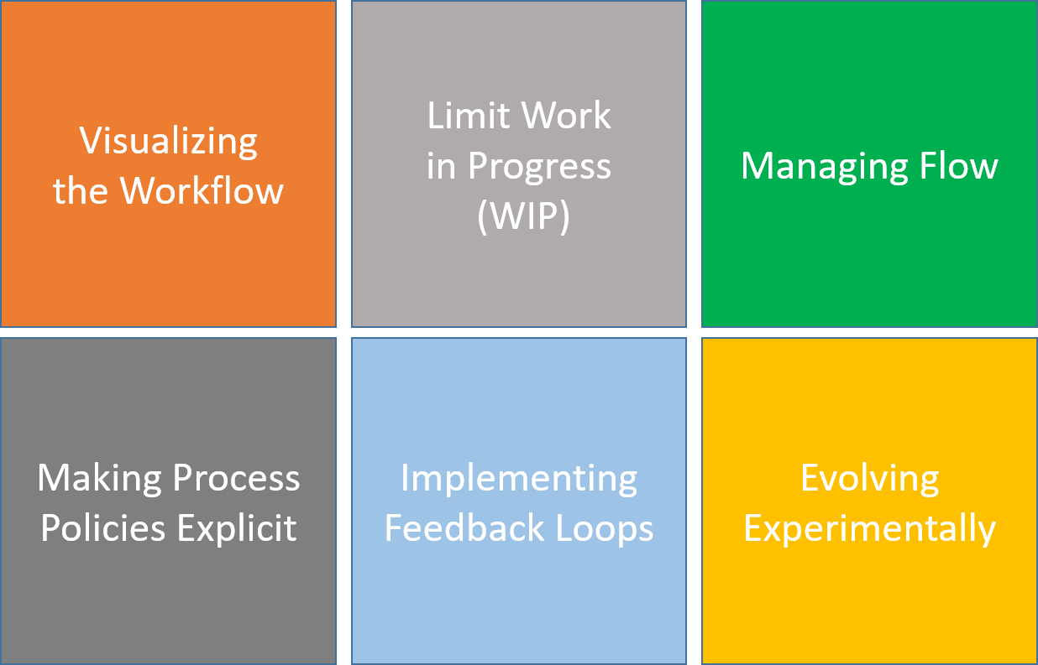



Practices of Kanban
Notes:
Besides the four principles mentioned above, there are six basic practices in kanban. Once you understand these six practices well, you will learn about the kanban process.

Slide 78
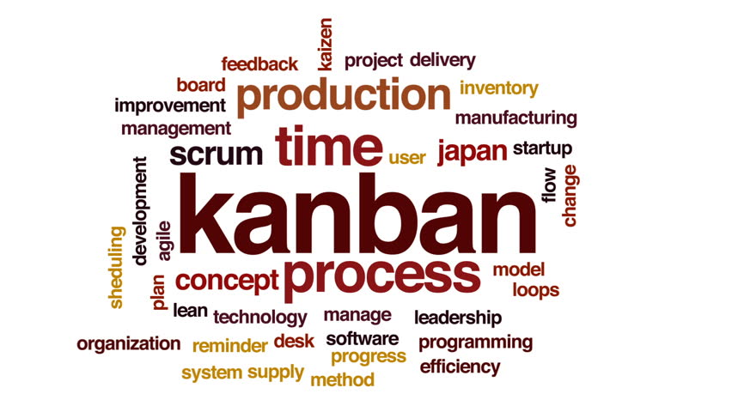
Kanban has 4 principles and
6 core practices.
True
False
Notes:
🍐 This is a Pear Deck Multiple Choice Slide. Your current options are: A: True, B: False,
🍐 To edit the type of question or choices, go back to the "Ask Students a Question" in the Pear Deck sidebar.

Slide 79

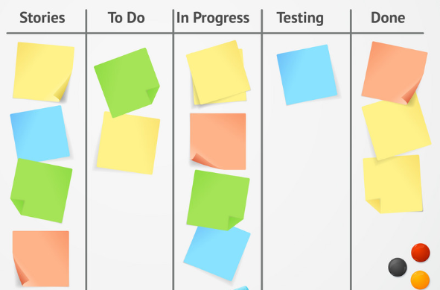
Visualizing the Workflow
First Practice
Visualization is the first step to start with Kanban
When you visualize the process, it can be seen what you and your team are currently doing

Slide 80
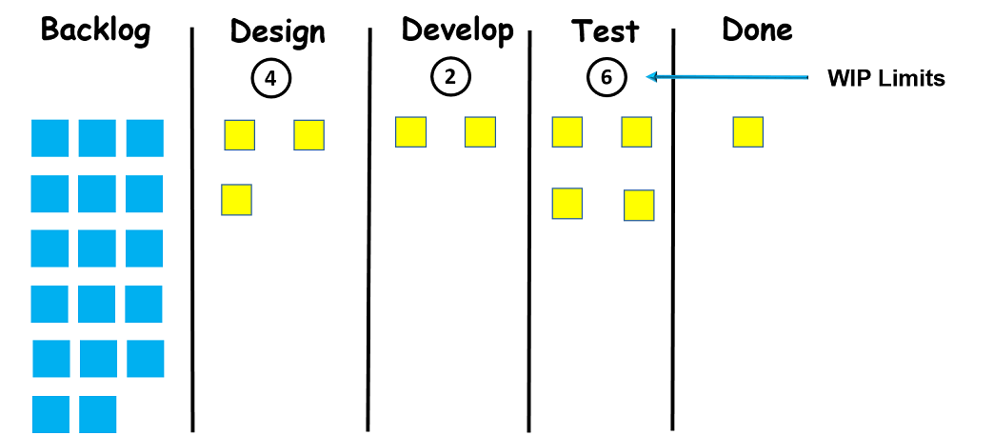
Limit Work in Progress (WIP)
Second Practice
When you assign a limit to each column, your team doesn't work more than they can handle
Notes:
Limitation of Work in Progress (WIP) is the second application of kanba. The maximum number of cards that can be in a column at any given time are called WIP limits. When you assign a limit to each column, your team won't work harder than they can handle.

Slide 81

Managing Flow
Third Practice
As you manage the flow and improve it, your team's pace becomes more predictable
This makes it easy for you to make commitments to your customers
Notes:
After the visualization and limiting each stage, the third application is all about improving the process flow. Managing and improving flow is the key point of your kanban system after implementing the first two applications. Because at this point there are two options. You will be faced with a smooth flow within the limits of Work in Progress or you will observe that jobs are starting to pile up. This affects the delivery time of the products.

Slide 82
Making Process Policies Explicit
Fourth Practice
Being explicit allows the team to follow the process easily and make proposals for the improvements
Team members who are not clear about the existing process can not improve the system
Notes:
Clarifying the process policies, basic principles and working methods is the fourth application of kanban. Being clear on these issues allows the team to easily follow the process and make suggestions for necessary improvements. In other words, team members who are not clear about the current process cannot improve the system.

Slide 83

Implementing Feedback Loops
Fifth Practice
You should know what your customers and the end-users think.
Automated continuously running tests are preferred as they shorten feedback loops.
Notes:
Here the fifth application comes into play, you need to get feedback from people who are not included in your system, like customers or end users.
Also, feedback loops are required within a system to ensure high quality delivery of the desired functionality. Different types of tests occur here. Continuous automatic tests are preferred because they shorten the feedback loops.

Slide 84
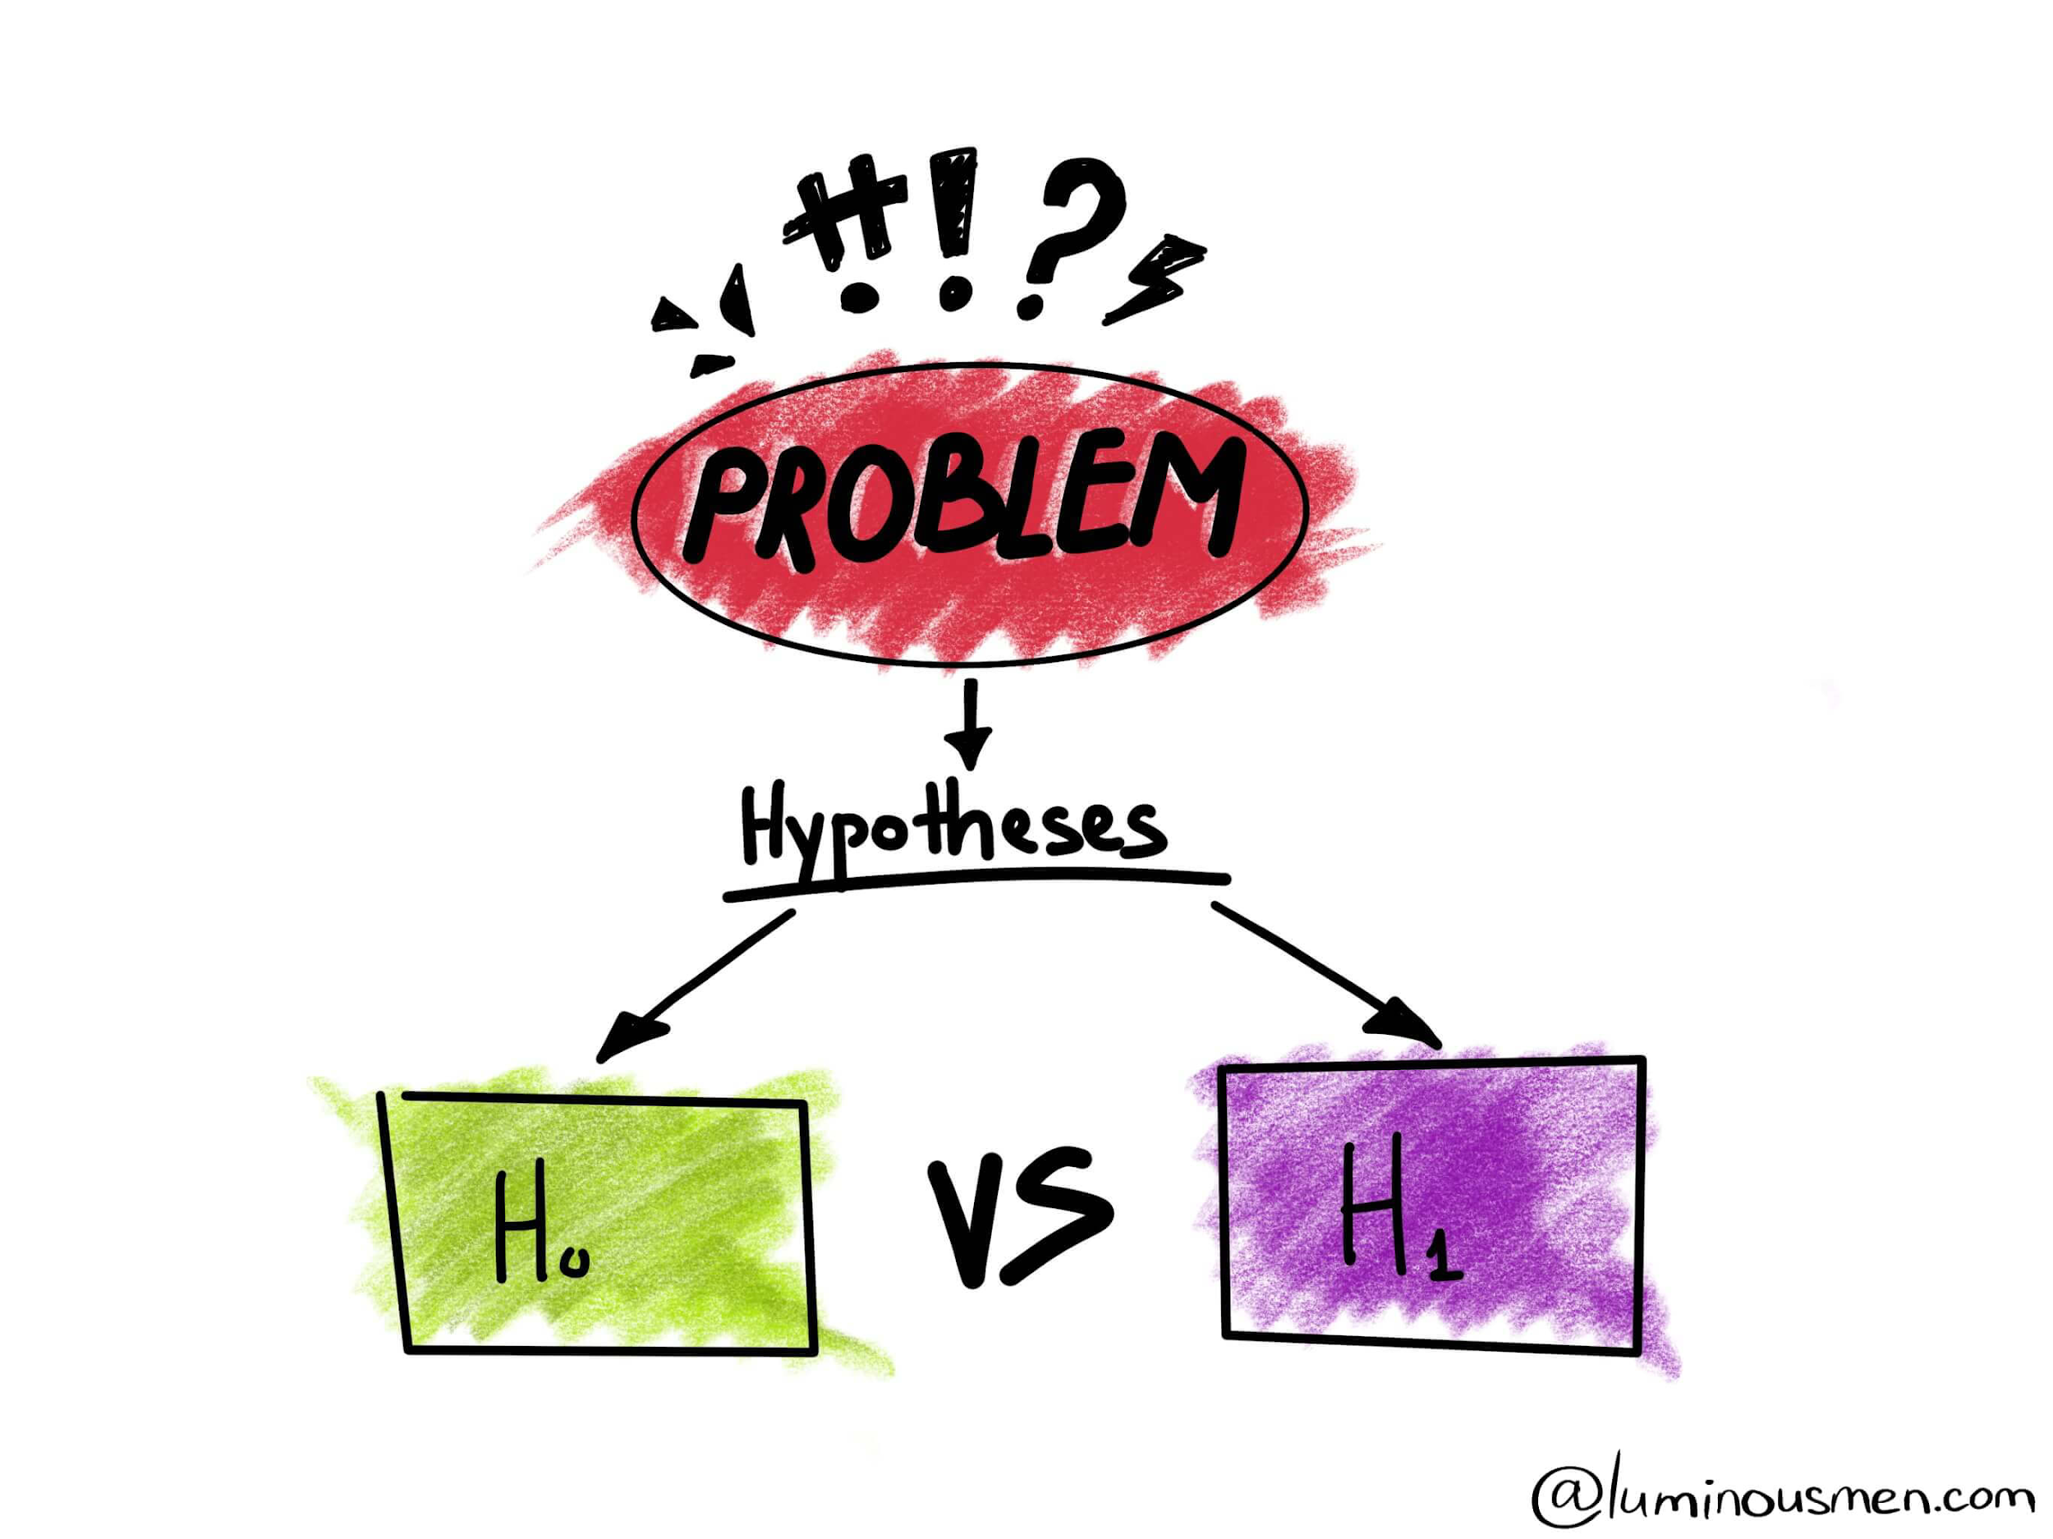
Evolving Experimentally
Sixth Practice
Kanban encourages you to use scientific methods like you form a hypothesis and test it
By using hypothesis testing, you can assess whether a change helps you improve or not
Then you make a decision about whether to try some other solutions or to keep the current status
Notes:
Since Kanban is an evolutionary improvement process, you must constantly evaluate and continuously improve your system. This allows you to make small changes in the process and improve the workflow at a constant pace.
If you are applying agile principles, your main task is to continuously evaluate your process and improve it as needed.

Slide 85
Kanban vs. Scrum
5

Slide 86
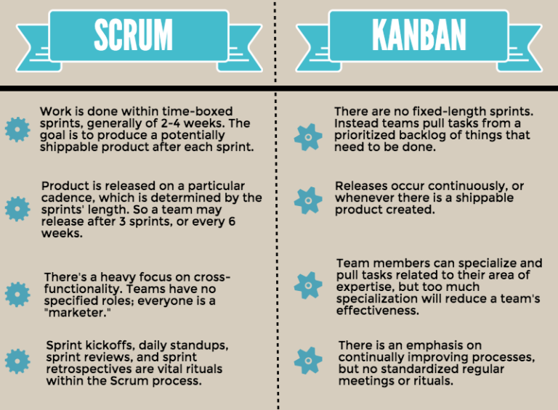
Comparing Kanban with Scrum
Notes:
It is not easy to completely separate the kanban and scrum methods. For example, most people believe that scrum teams use kanban boards in the scrum process. On the other hand, there are some fundamental differences between the two methods.
While sprints in Scrum have start and end dates, there is no specific time limit in kanban,
While there are deadlines for tasks on the Scrum board, kanban is more flexible in this regard,
Unlike the roles set in a Scrum project such as the Product Owner, Scrum Master and Development Team, there are no specific roles in Kanban,
While the team rearranges the Scrum board after each sprint, the same kanban board is used throughout the project.
Scrum is the better choice when you need a more specific process.
However, if you want to improve the execution of the process without making too much change in the whole scenario, you should use Kanban.

Slide 87
Which statement cannot be said while comparing Kanban with Scrum?
Notes:
🍐 This is a Pear Deck Multiple Choice Slide. Your current options are: A: There are no certain roles in Kanban., B: Scrum is more flexible than Kanban., C: There is no certain time limits in kanban while sprints in scrum have a start and end dates.,
🍐 To edit the type of question or choices, go back to the "Ask Students a Question" in the Pear Deck sidebar.
Which statement cannot be said while comparing Kanban with Scrum?

Slide 88
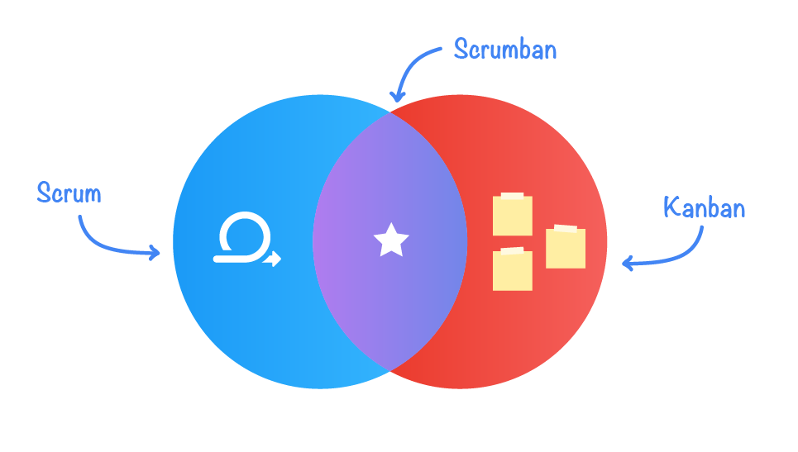
Scrumban
Notes:
Scrumban is combination of scrum and kanban as you can understand from the name.
We know Scrum and Kanban as Agile's methods. Scrum is best suited for products and development projects. Kanban is best for production support.
We use Scrumban for maintenance projects, combining the best of both. Scrumban has become very popular these days in service industries with both development and maintenance projects.
Scrumban emerged to minimize the workload and meet the needs of teams looking to adopt a pull-based system.
A hybrid of Scrum and Kanban gives teams the flexibility to adapt to stakeholders and production needs without feeling overloaded by project methodologies.
Scrumban offers a versatile approach to workflow management by providing the flexibility and visualization of Kanban to Scrum's structure.
Scrumban can also be used as a stepping stone for teams looking to move from Scrum to Kanban.
For many software development teams, it will be very difficult to switch to Kanban immediately. Scrumban offers teams a way to learn about continuous improvement practices in Kanban without leaving the familiar nature of Scrum.

Slide 90



How well did you like this lesson?
Notes:
Temperature Check
Get a sense for how well your lesson resonated with your students, or how engaged they were.
🍐 This is a Pear Deck Draggable™ Slide.
🍐 To edit the type of question, go back to the "Ask Students a Question" in the Pear Deck sidebar.

Slide 91

THANKS!
Any questions?
You can find me at:
@Martin - Instructor
martin@clarusway.com

